Slide 1
ERC Discussion
Date: 25/10/2020

Slide 2
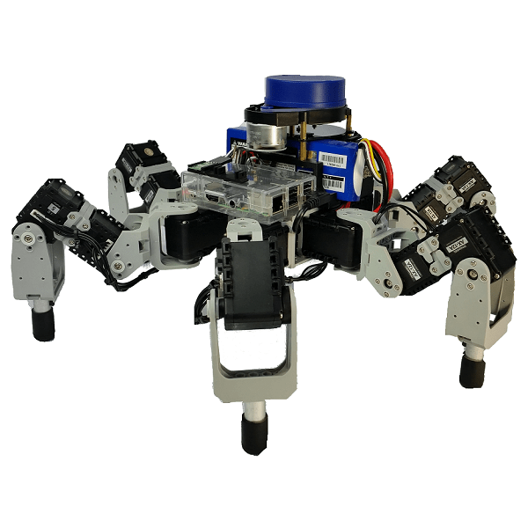
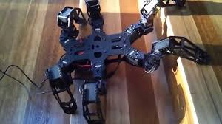
Inspiration
Rhoeby Hexapod

Slide 3
Similar projects that inspired us
Rhoeby Hexapod
ASTERIX Hexapod (Video)
Our initial inspiration for the project was Quadruped by Mohit Bhaiya and Abhimanyu Bhaiya
RoMeLa Vertical wall climbing

Slide 4
Legged Robotics
Types of legged robots
One-legged robots (pogo stick robots)
Two-legged robots (Bipedal robots)
Two-legged robots (Bipedal robots) can exhibit bipedal motion, Stability is maintained by calculating each step and moving the weight in a well-defined way, but they face two primary problems: stability control that refers to the robot’s balance, and motion control that refers to the robot’s ability to move
Three-legged robot (Tripodal robots)
Three-legged robots are statically stable, there are three contact points to the ground, Tripodal robots are well balanced, they can stand without toppling over.
Four-legged robots (Quadrupedal robots)
Six-legged robots (hexapods)
Six-legged robots (hexapods) offer greater stability than bipedal or quadrupedal robots, They have 6 legs, Their final designs mimic the mechanics of insects.

Slide 5
Advantages of legged robots
Following are few advantages of legs over wheels:
Legged robots or vehicles can navigate on any kind of surfaces which is inaccessible for robots with wheels. In the previous section, we discussed different kinds of wheels for different surfaces, but no standard works on all surfaces. Also, wheels are designed to work on prepared surfaces like smooth surfaces, roads, rails, etc.
Legged robots can jump or step over obstacles whereas wheels need to somehow travel over it, or take a different path
Wheels require a continuous path to travel whereas legs can step over isolated paths and move on. For example, if a particular city is hit by an earthquake, then the surface with a continuous path. This is where legged robots come into picture, although tracked wheels can manage up to a “certain” extent.

Slide 6
Types of walking gaits
Hexapod robots can be divided into two categories. Rectangular hexapods have a rectangular body and two groups of three legs placed symmetrically along the two sides. Hexagonal hexapods have a hexagonal or circular body, with legs distributed evenly. Rectangular hexapods are considered less stable and efficient that hexagonal types.
3+3 Tripod Gait
This walking mechanism involves the robot having three legs standing on the ground supporting the body while the other three swing forward
4+2 Quadruped Gait
Legs 1 and 4 swing whereas others leg give support, (right side 1,2,3 left side 4,5,6), not seen in insects.
5+1 One by One Gait
In this gait, legs simply move forward one after the other in a clockwise or anticlockwise fashion while the other 5 legs are in 'stance phase'
Free Gait
This gait has no fixed or periodic gait; rather its walking mechanism is determined by the terrain and the machine's state . This mechanism is very complicated but gives the robot a more flexible gait to better cross complicated terrain. This gait type is not seen in insects.

Slide 7
Project Goals
To find and test optimised
Leg trajectories
Different Gaits
Controller algorithms
Physically implement all these algorithms on a hexapod
Step Climbing
Notes:
Started with Quadruped

Slide 8
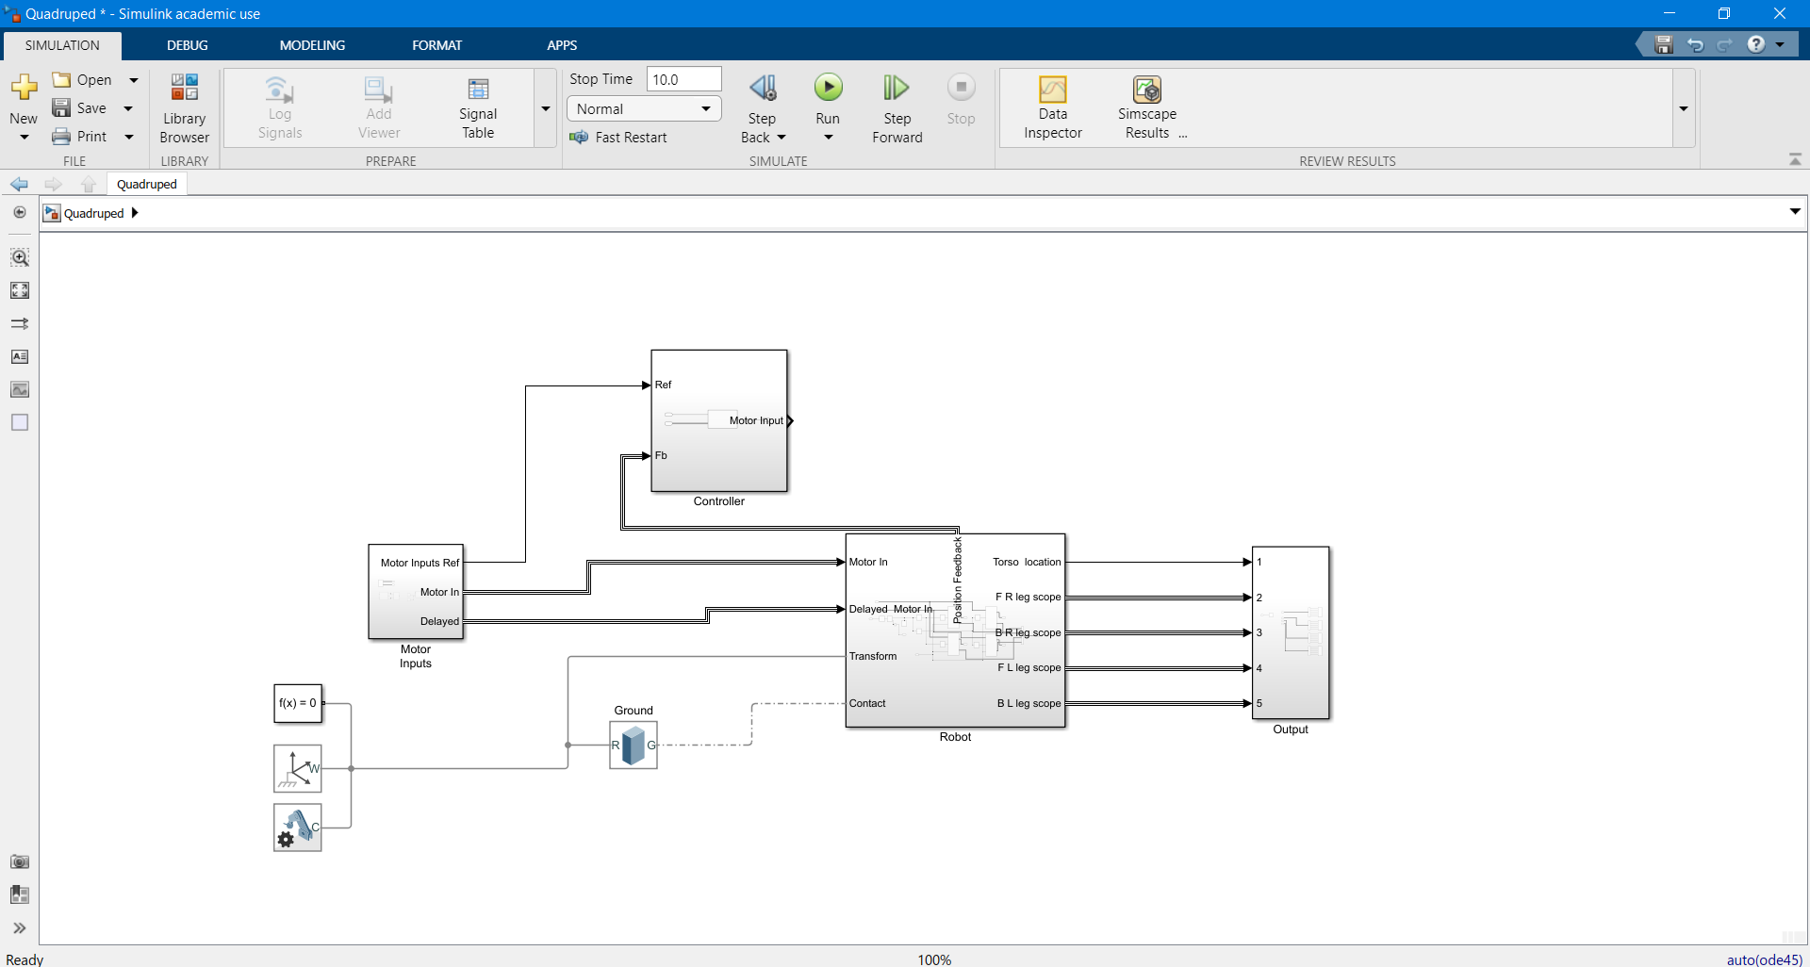
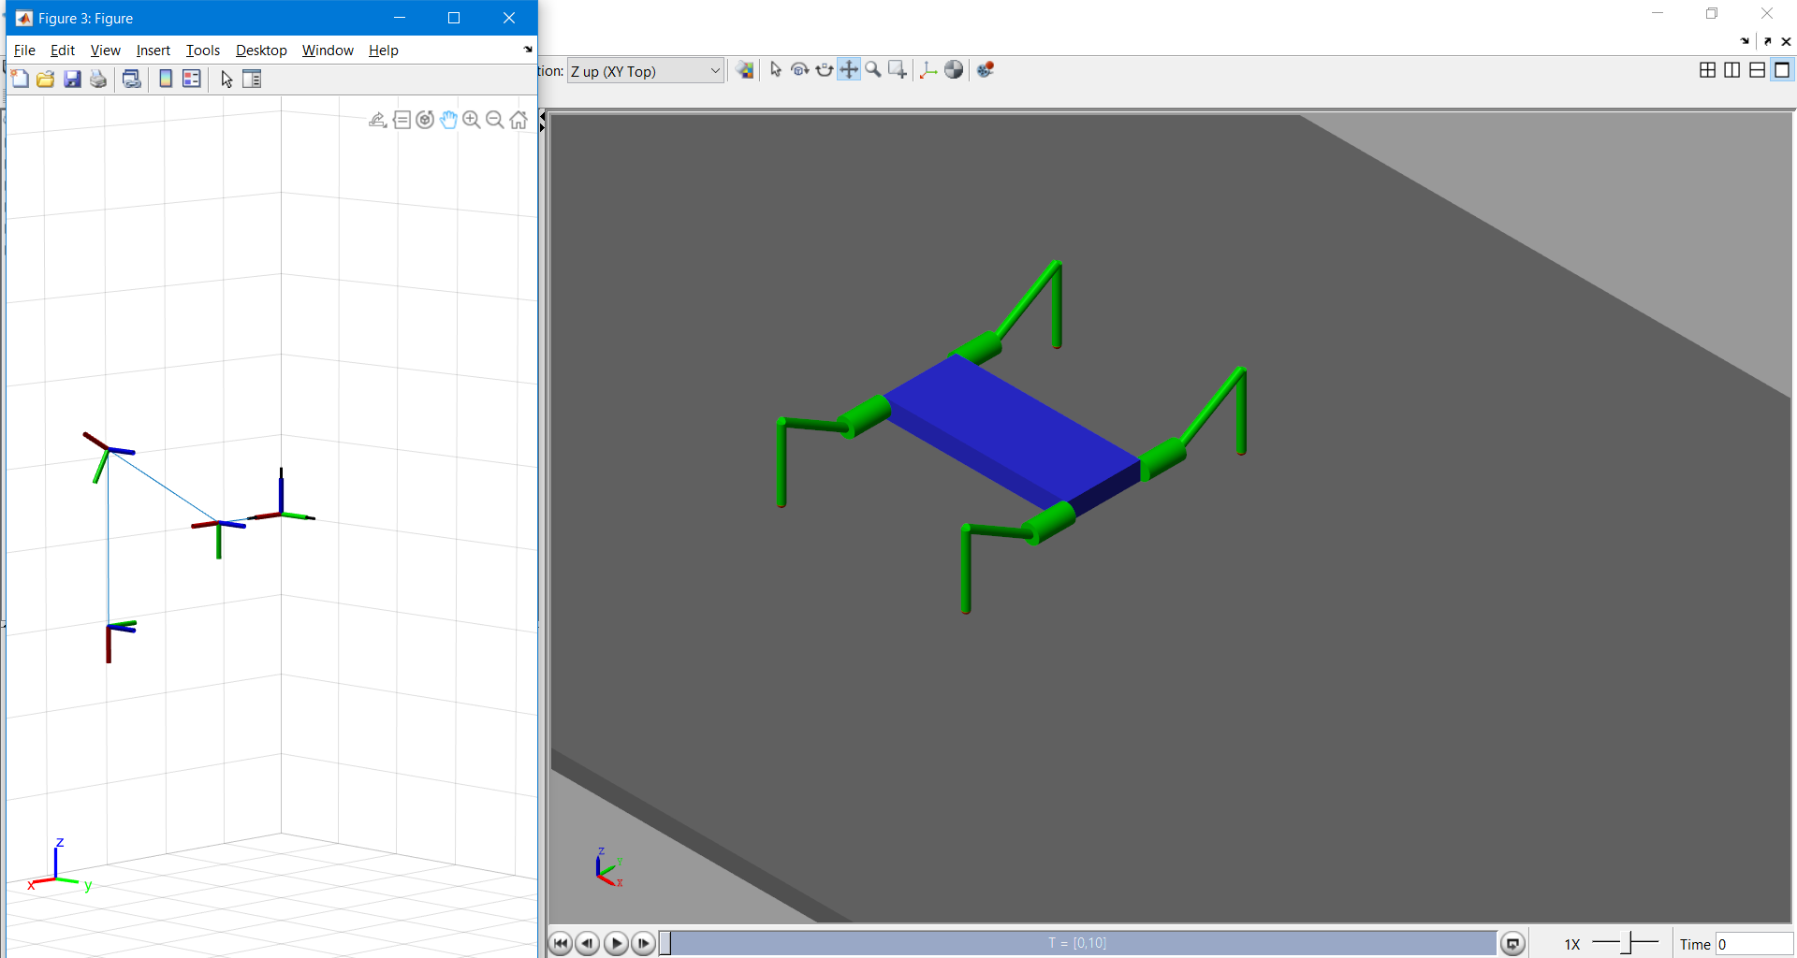
Simulink Model
Notes:
Explain through Matlab

Slide 9
ZMP & LIPM
Why and what ZMP & LIPM
Zero moment point is a concept related with dynamics and control of legged locomotion, e.g., for humanoid robots. It specifies the point with respect to which dynamic reaction force at the contact of the foot with the ground does not produce any moment in the horizontal direction
The linear inverted pendulum is a model that gives a simple dynamics of a biped walking robot. We overview the pioneering works of biped robot modeling and control and then introduce a method to derive linear dynamics of a 2D biped robot which walks on flat ground.
For a quadruped with mass concentrated in torso we can assume LIPM and apply ZMP
In pace gait only two legs of the robot will be in contact with ground thus it can be assumed similar mechanism to biped and thus is a good choice for zmp
Accuracy of ZMP is not so much because LIPM is a far approximation on it

Slide 10
Current Problems (Where we need help)
Inverse Kinematics algorithm (recursive)
Dynamics and further modelling
Pybullet Optimisation problem
Physical Modelling and Designing of the robot

Slide 11
BAHUT AABHARI
Thanks for listening !

